Slide 1
Federating open innovation in cities
Fed4Cities
Christophe Munilla
Levent Gürgen

Slide 2






























Federating open innovation in cities
FED4CITIES
LWM2M
CDMI
Platform
IoT platforms
Experiment description
2

Slide 3
sensiNact - SmartSantander Integration
Background & motivation
Kentyou’s main mission: addressing the smart city interoperability challenge with an open innovation approach.
Vendor lock-in and uninteroperable solutions
No interaction among city divisions, creating silos
3
FED4Fire - SensiNact SmartSantander Integration

Slide 4
sensiNact - SmartSantander Integration
Concept & Objectives
Main goal: testing the interoperability approach with a real life environment
4

Slide 5
sensiNact - SmartSantander Integration
Concept & Objectives
Overview : sensiNact connected to SmartSantander API, collecting events triggered by the system and unifying the collected data to be used by the developed sensiNact applications.
Objective 1: Enable the data interoperability in a city infrastructure
KPIs:
Number of connected devices > 500 devices
Learning curve to build a bridge < 5 days
Objective 2: Rapid prototyping of city applications
KPIs:
Number of developed applications (rule-based and programmatic) = 3
Number of involved data and action sources > 50
Learning curve to develop an application < 5 days
5

Slide 6
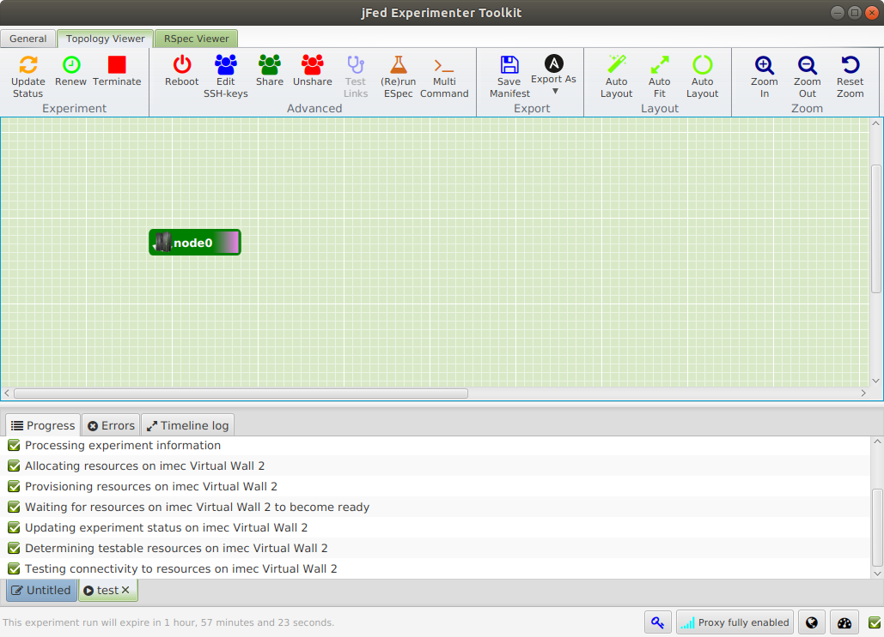
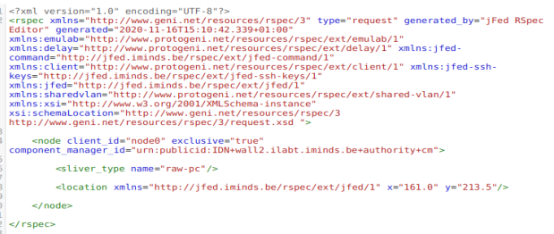
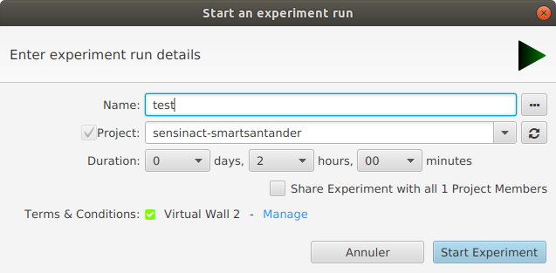
sensiNact SmartSantander Integration
Experiment set-up
Configuration of the test using JFed Tool.
Initial test on a single physical node on which a Java runtime environment and sensiNact instance has been installed
6
FED4Fire - SensiNact SmartSantander Integration

Slide 7
Federating open innovation in cities
FED4CITIES
LWM2M
CDMI
Platform
IoT platforms
Project results
7

Slide 8
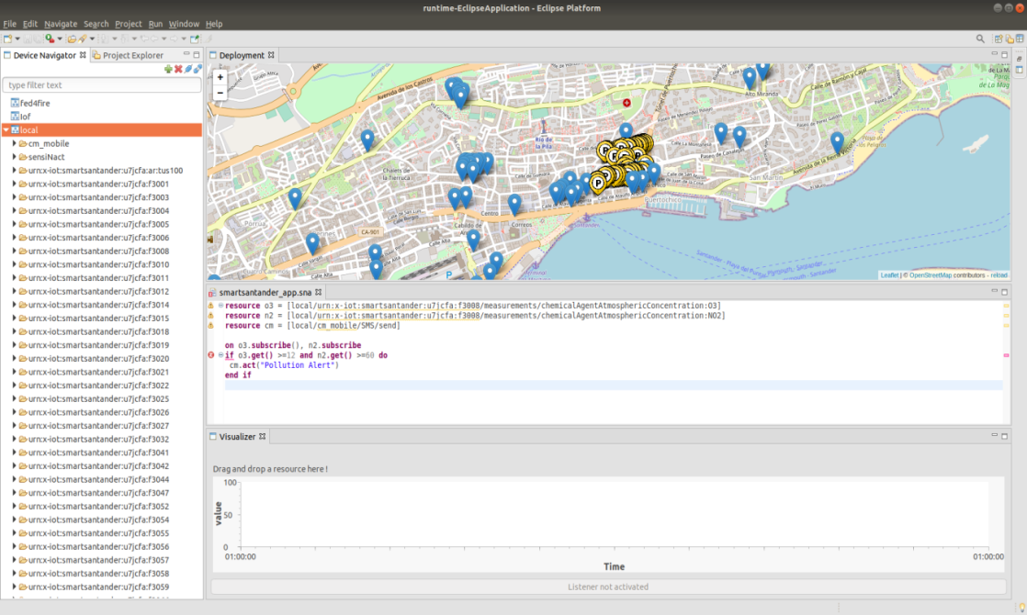
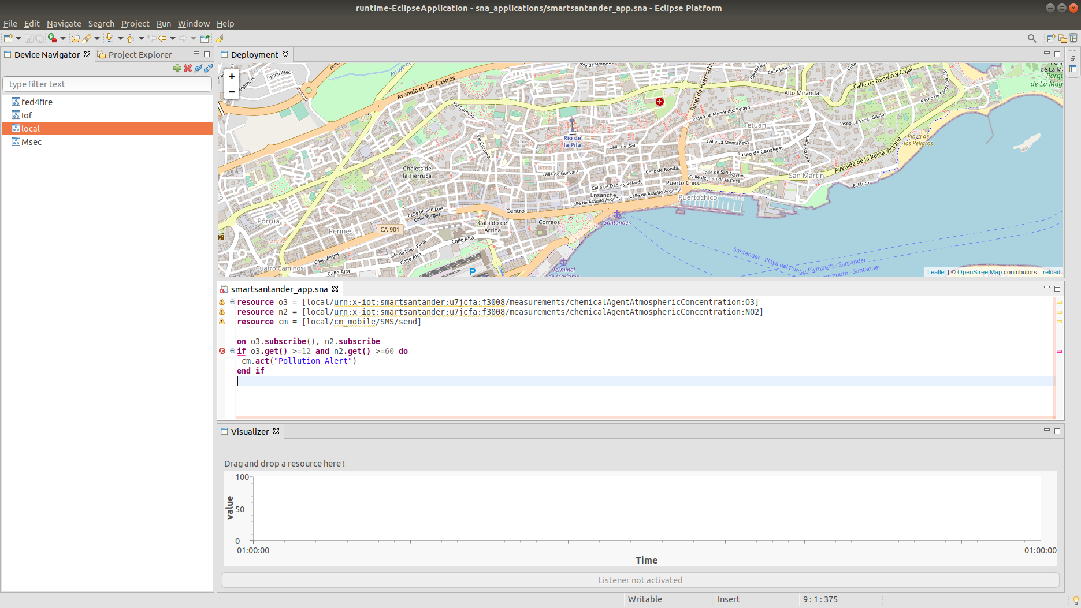
sensiNact SmartSantander Integration
Measurements
307 connected nodes (parking sensors, environmental sensors, etc. - fixed and mobile) to collect all the observations and reified them into the sensiNact platform
2 rule based applications created using the sensiNact Studio triggering alerts when pollution measures reach some predefined limits

Slide 9
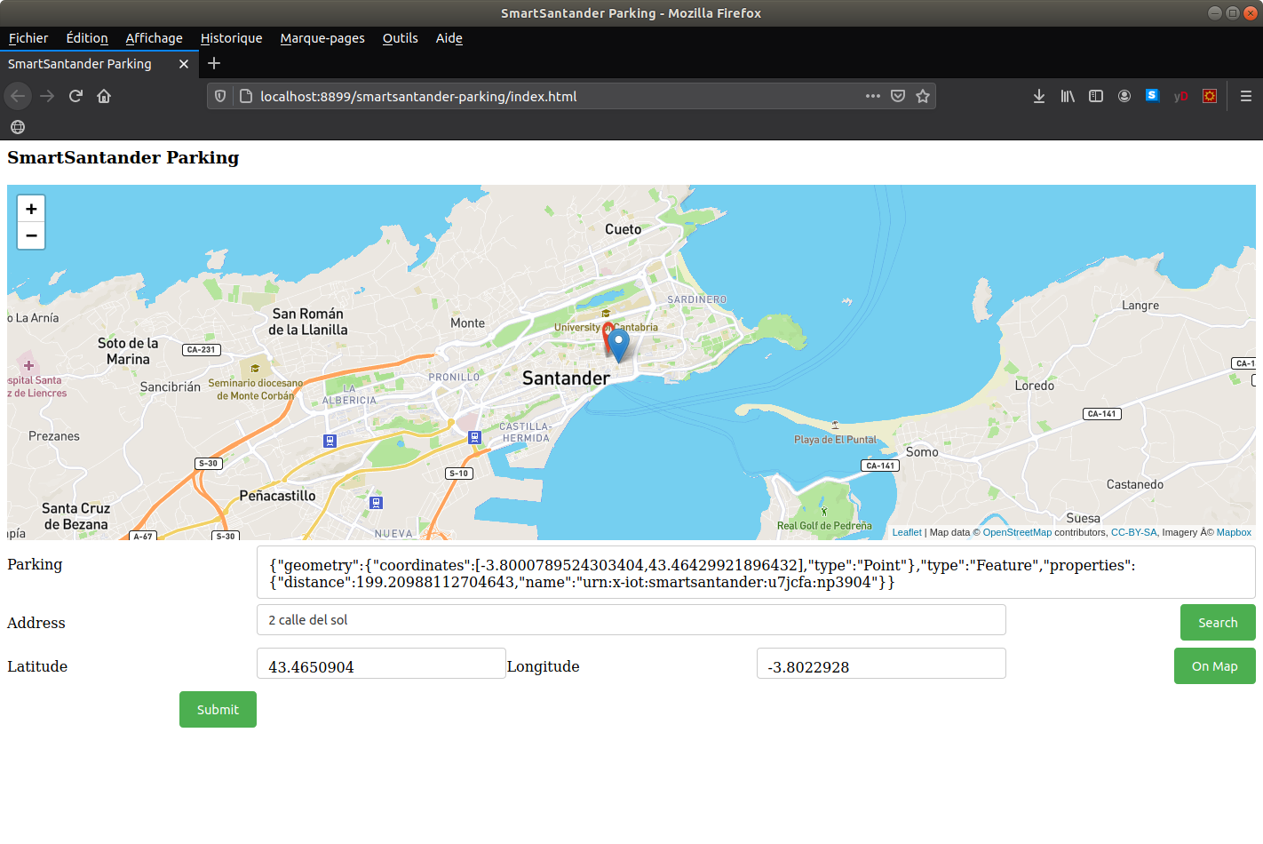
sensiNact SmartSantander Integration
Measurements
1 Web application allowing to retrieve the coordinates of the available parking spaces closest to a given destination

Slide 10
sensiNact SmartSantander Integration
Lessons learned
Need Security improvement to handle client certificate for TLS connection
  Need of automatic and configurable subscription / unsubscription mechanism
Improvement of the development tool to generate complex applications easier
Need for additional features for the sensiNact Studio, such as multi layered maps offering different views
Need for integration of the data analysis mechanism with the sensiNact Studio (AI layer to help at business logic evolution)

Slide 11
Federating open innovation in cities
FED4CITIES
LWM2M
CDMI
Platform
IoT platforms
BUSINESS IMPACT
11

Slide 12
sensiNact SmartSantander Integration
Business Impact
Why FED4FIRE+?
Smart city solutions should be validated in real life environments
Smart Santander provides the unique possibility of working with real devices and close to operational environment
Startups and SMEs can not setup such large scale infrastructures
Unique opportunity for small companies

Slide 13
sensiNact SmartSantander Integration
Business Impact
Opportunity to demonstrate our added value: breaking silos, building easily cross-domain applications
FED4Cities 2nd phase
FED4Cities 1st phase

Slide 14
sensiNact SmartSantander Integration
Business Impact
Allowed technical improvements towards our MVP prototype:
Definition of a set of maven archetypes allowing to generate a wide range of applicationsplications easier
Implementation of a configurable business concepts layer (targeting possible Domain Driven Design layer)
Allowing of multiple GeoJSON layers in sensiNact Studio
Allowing of parameterization of TLS connection with client certificate
  Building of automatic and configurable (remote) subscription / unsubscription mechanism
  Implementation of AI Layer (identifying statistic correlations, implementation of predictive service, etc… )

Slide 15
sensiNact SmartSantander Integration
Other value perceived
Real life data
Quick prototyping, experimentation setup
Wide range of sensor devices, data types, hardware on which to experiment
Wide range of network topologies possibly defined
Helpful in precising system limits

Slide 16
Federating open innovation in cities
FED4CITIES
LWM2M
CDMI
Platform
IoT platforms
FEEDBACK
16

Slide 17
SensiNact SmartSantander Integration
FED4Fire – Used Tools
A physical node was used to put the test in place
Configuration and execution of the test using the JFed graphical interface
Once the node launched, copy of both the java runtime environment and a sensiNact distribution
It might be possible to install more than one instance in charge of holding the web application in combination with some load balancing mecanism

Slide 18
SensiNact SmartSantander Integration
FED4Fire – Used Resources
All resources providing events in SmartSantander testbed were reified in the sensiNact platform.
The rule-based applications use on one hand mobile sensors providing pollution measures and on the other hand an external webservice allowing to send SMS using an HTTP API. We also used the sensiNact Studio to create these applications
The programmatic application uses the parking sensors, but also an external webservice allowing to retrieve the coordinates of an address

Slide 19
SensiNact SmartSantander Integration
FED4Fire Added Value
Unique environment to facilitate experiments with real life city data
Possibility of the federation with other testbeds
  Federation will be done with CityLab and Tengu in the second phase

Slide 20
SensiNact SmartSantander Integration
FED4Fire Added Value - Technical
Efficient tool allowing to easily configure an deployment environment
Reproductibility (scripting, disk image)
Security concerns
Well documented

Slide 21
Questions ?

